Slide 1
NCOP LiNCHigher Project
Dr Rob Vickers
Research Fellow

Slide 2
National Collaborative Outreach Programme (NCOP)
Funded by HEFCE - £60 million per year
High level aim:
To increase the number of young people from disadvantaged backgrounds in higher education by 2020.
The programme consists of 29 consortia:
Undertaking outreach activity in geographical areas where the HE participation of young people is both low and much lower than expected based on GCSE-level attainment.

Slide 3
Participation of Local Areas (POLAR)
POLAR classifies wards into five groups, based on the proportion young people who enter HE aged 18 or 19:
Quintile 1 areas - lowest young participation rates
(most disadvantaged)
Quintile 5 areas - highest young participation rates
(most advantaged)

Slide 4
HE application rates for 18 year olds (England)

Slide 5
LiNCHigher
A partnership of 11 education providers and organisations across Lincolnshire

Slide 6
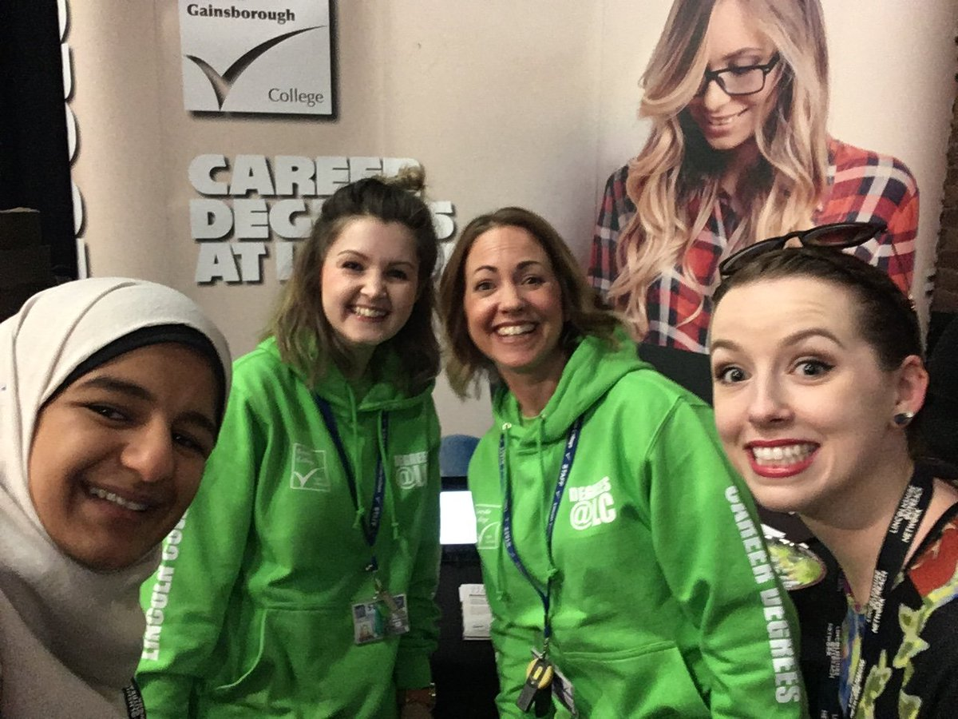
LiNCHigher Project Team

Slide 7
Lincolnshire Gaps Areas
Gaps Area 1: Gainsborough
Gaps Area 2: Lincoln
Gaps Area 3: Coastal
Gaps Area 4: Boston
Gaps Area 5: Grantham
Gaps Area 6: South

Slide 8
LHERI is evaluating the LiNCHigher project on a local level
What’s important locally to enabling participation in HE
Issues impacting upon (enablers to) participation in HE
What needs to be in place to make widening participation (WP) work locally
What needs to be done to see widening participation and progression to HE

Slide 9
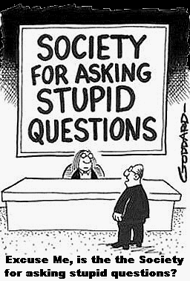

Slide 10
Please stand up!

Slide 11
Please sit down if…
When you were 13 to 18 you lived in one of these wards -
Billinghay | Gainsborough South-West | Skirbeck
Castle | Glebe | St Clement's
Central | Holbeach Hurn | Staniland North
Chapel St Leonards | Long Sutton | Sutton Bridge
Coningsby and Tattershall | Mablethorpe Central | Sutton on Sea South
Earlesfield | Mablethorpe East | Swineshead and Holland Fen
Fenside | Moorland | Winthorpe
Gainsborough East | Scarbrough | Wyberton

Slide 12
Please sit down if…
You had not planed to go on to higher education when you were at school?
When you went to higher education, you were the first person in your family to go?

Slide 13
IMPACT

Slide 14
Measuring Impact
Proxy Measures
Knowledge about HE
Attitude towards HE
Aspirations for the future
Intention to apply to HE
Aspirations for the future

Slide 16
What is a logic model?
A logic model is a graphic depiction of the relationships among the key elements of a project:
• inputs,
• strategies,
• objectives,
• long-term goals.
A logic model …
Helps to articulate the key elements of the project.
Enables evaluation efficiency and effectiveness.
Promotes stakeholder buy-in by helping clarify how the project works.
Provides a great opportunity to involve stakeholders in planning.

Slide 17
LiNCHigher Logic Model
Inputs | Activities | Outputs | Short to medium term goals | Longer term outcomes | Impacts
Resources required to achieve objectives | What you will do / deliver with the inputs | Quantifiable results of the activities | Short / medium term effects generate by outputs | Longer term effects generated by outputs | Intended impact of investment
 |  |  |  |  | Double the proportion of young people from disadvantaged backgrounds in HE by 2020 Increase by 20 per cent the number of students in HE from ethnic minority groups Address the under-representation of young men from disadvantaged backgrounds in HE
Assumptions – Necessary pre-conditions for the activities to lead to the outcomes

Slide 18
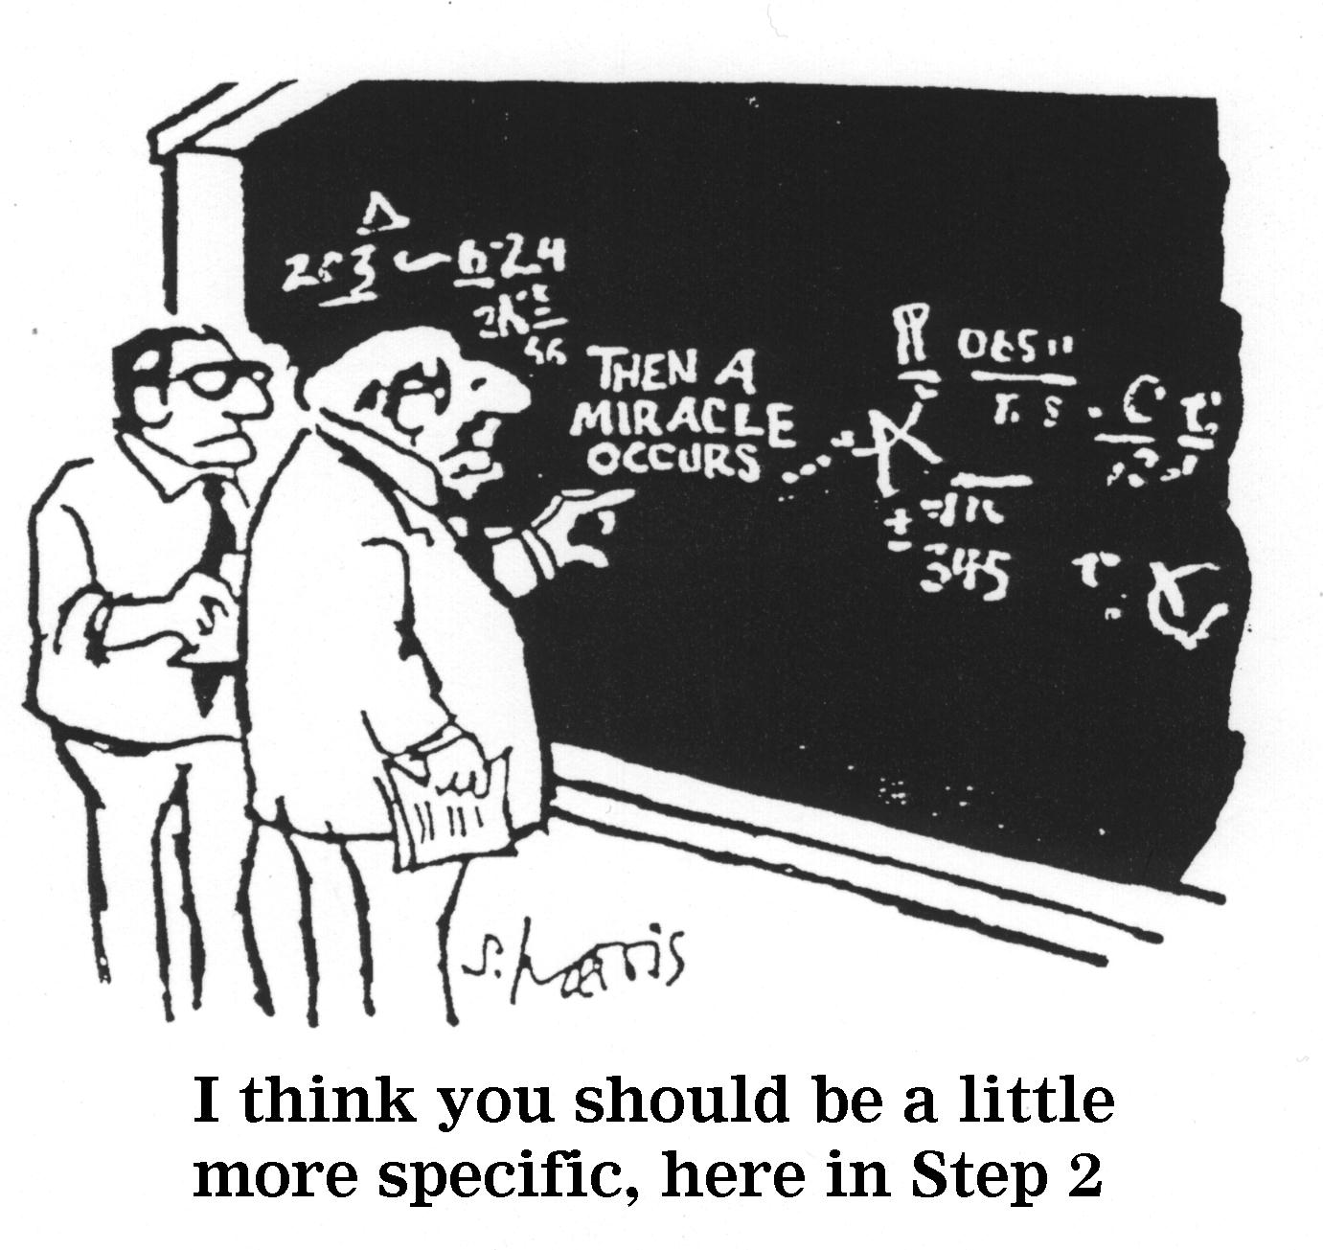

Slide 19
Finding Impact
Generating data
Mixed methods approach
Involving stakeholders
Positive step-change in how widening access is evaluated by HEIs.

Slide 20
Quantitative Data

Slide 21
Student Feedback

Slide 22
Baseline Survey

Slide 23
“Explaining the Gaps”
22 Questions
55 Data points
29 Schools
4,000 NCOP students
22,000 participants

Slide 24
Can you please help!
With the person sitting next to you, can you please discuss:
What’s important to enabling participation in HE?
What activities might encourage young people to participate in HE?
Questions?

Slide 25
Thank you!
rovickers@Lincoln.ac.uk

